Slide 1
Recommendations for Grouping, Targeting and Filtering in MEM
Matt Toto, Modern Experience SME
Notes:
Good Day everyone. My name is Matt Toto, I recently joined the FastTrack Modern Experience team as a SME. I’ve been with Microsoft for 11 years. Most recently as a Customer Engineer dedicated to a few S2500 customers and prior to that was in the Support wing of the CSS org doing break/fix support for ConfigMgr.

Slide 2
Agenda
Overview
Recommendations
Recap
Notes:
Intune grouping, targeting, and filtering: recommendations for best performance - Microsoft Tech Community

Slide 3
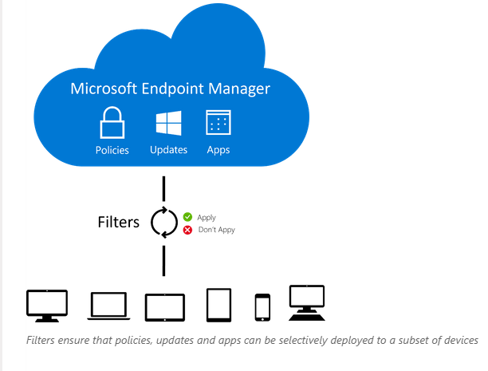
Key Concepts
Azure Active Directory Groups
  Used almost exclusively
Virtual groups, default/built in
  All Users/All Devices
Filters
  Applicability evaluation at device check-in
  Ex. Washington Sales Users, install only on Corporate iPads
Notes:
AAD Groups
Includes both Security and M365 Groups
Assigned or dynamic device and user groups
Any time you are working with GROUPS in the MEM admin center what you are looking at are Azure AD groups
Intune syncs from AAD – only ‘important’ groups aka those that are targeted, and only users in those groups who are Intune licensed
Groups are important because they are used for things like
Assigning policies
Assigning apps
Scoping in RBAC
Virtual groups
- Are an Intune construct
exist by default in every tenant, no management overhead (queries to update)
don’t need to sync from Azure AD like other groups
Filters
NOT Groups
Dynamic evaluation of applicability. It is high performance, low latency and happens at device check-in
Kind of like the reverse of ConfigMgr collections. Rather than define the criteria to build the group, that you target, you just target the large group and filter in or out
Use filters to narrow assignment scope of apps or policies
Filter in or out based on device properties (name, mfg, model)

Slide 4
Recommendations for best performance
Use virtual groups
Re-use groups
Make incremental group changes
Use filters to include and exclude
Notes:
Next we’ll dive into each of these 4 recommendations to discuss/review Do’s and Don’t’s
These are our base recommendations for BEST PERFORMANCE.

Slide 5
Use virtual groups
Don’t | Do
Don’t create your own “All users” or “All devices” groups for use in Intune targeting or RBAC. | Use virtual groups All users and All devices where possible. Use filters to achieve granular device applicability. “Pre-stage” large groups(>30k) for faster deployment when you need them.
TIP: ‘Pre-stage’ large groups by first using it in the admin center, either an RBAC scope assignment or benign policy.
Notes:
DO
All User and All devices
Intune-only construct, no syncing between AAD and Intune
Same for Filters, allows for dynamic applicability at check-in
Use filters where possible to avoid performance issues
New groups, never used in Intune before, undergo first time setup process aka. Full sync and it takes longer than deltas
Pre-staging large groups by using them somewhere in the MEMAC before assigning the actual deployment can improve performance
DONT
Large groups (e.g. ‘All Windows’) can lead to possible sync bottlenecks that hold up other processing

Slide 6
Re-use groups
Don’t | Do
Don’t create duplicate copies of the same group to target different policies. Don’t create dedicated “App groups” or “Policy groups”. | Re-use the same group objects for assigning multiple policies.
TIP: 1 group with 10 polices > 10 groups with duplicate members, each with 1 policy
Notes:
Behind the scenes, Intune converts Azure AD group members to assignment targeting messages for each user and device. This process is highly optimized when the group objects are the same. Inefficient group sync design can impact the speed at which new assignments can be created and delivered to devices. As
Said another way, using an example, Intune grouping and targeting works best when the “Engineering” user group is targeted with 10 policies, rather than the Engineering users being used as members of 10 different groups each with their own policy
We don’t recommend using dedicated groups b/c it dramatically increases the number of Azure AD groups that Intune must subscribe to and monitor for membership updates, which is less efficient.

Slide 7
Make incremental group changes
TIPS
Large AAD group membership changes can slow down targeting of other assignments in your environment.
Add child groups to the parent gradually over the course of a few days rather than all at once.
Don’t | Do
Don’t make big group nesting changes all at once. | Make incremental changes to build out nested groups.
Notes:
1. Large group membership changes in AAD result in bursts of targeting changes in Intune and can slow down targeting of other assignments in your environment
2. Example: Creating a deploying targeting 180k devices. An example of how you’d want to structure this to avoid performance delays would be to create the EMPTY parent group and plan to have 3 child groups each with ( 30k, 60k, 90k) respectively. Adding one child group to the parent over the course of 3 days. Using this method would result in policy being applied to all devices over 6 days.

Slide 8
Use filters to include and exclude
TIP: Assign to a User Group, use filters to dynamically include or exclude the appropriate devices.
Don’t | Do
Don’t mix user groups and device groups when using Include and Exclude groups. | Use filters to achieve the right user+device combination for targeting.
Notes:
Created at the tenant level. Tenant Administration – Filters
Preview feature
For example. A Windows 10 restriction policy assigned to the All Users group. Lets say the customer has allowed BYOD and you only want this policy to apply to Corporate devices. You would create the policy and on the assignment page chose the filter to Inlcude corporate devices. If you maybe want to target on Personal devices you could use this same filter to Exclude Corporate devices.
Because in tune has to subscribe and sync to those azure AD groups, and for dynamic groups it will take time for a user/device to find its way into that group. The better way to do it is to use filters and assign to the all device or all users group. Use a filter which gets applied when the client checks in to decide what to do about the policy. It's the reverse of SCCM thinking where you create a collection of all the machines that meet the criteria for your deployment first. We all know how it goes when you don't create those queries and collections efficiently.

Slide 9
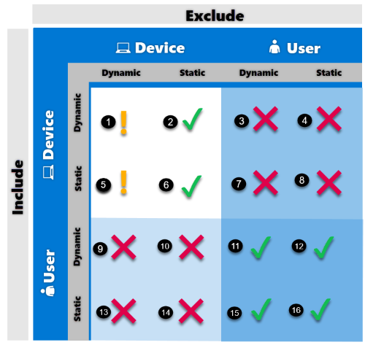



Tips – Exclusion Matrix
Supported
Partially Supported
Not Supported
Notes:
Review just a couple of these, the full list is here: Assign device profiles in Microsoft Intune | Microsoft Docs
2. Supported - Assigning a policy to a dynamic device group while excluding a static device group is supported.
3. Not supported - Assigning a policy to a dynamic device group while excluding user groups (both dynamic and static) isn't supported. Intune doesn't evaluate user-to-device group relationships, and devices of the included users won't be excluded.
5. Partially Supported - Assigning a policy to a static device group while excluding a dynamic device group is supported. But, it's not recommended in scenarios that are sensitive to latency. Any delay in exclude group membership calculation can cause policies to be offered to devices. In this scenario, we recommend using filters instead of dynamic device groups for excluding devices.

Slide 10
User groups vs. Device groups
Use a User group when… | Use a Device group when…
Ex. assigning User certificates | No dedicated user
Control features in apps (ie. OneDrive, M365 Apps) | Device-wide setting (ie. Disable camera, update firmware)
Want settings/rules to follow user across devices | Don’t care about who is signed in on the device

Slide 11

Tips – Follow Scott Duffey on Twitter!
Notes:
Scott’s deep dive video- Microsoft Endpoint Manager: A deep dive on grouping, targeting and filtering​ - Microsoft Tech Community
Blog that I converted to slides - Intune grouping, targeting, and filtering: recommendations for best performance - Microsoft Tech Community

Slide 12
Recap
Overview
Recommendations
  Use virtual groups (All Users/All Devices)
  Re-use group whenever possible
  Make large group membership changes incrementally
  Use filters to INLCUDE or EXCLUDE

